Slide 1
Kubernetes
Workshop

Slide 2
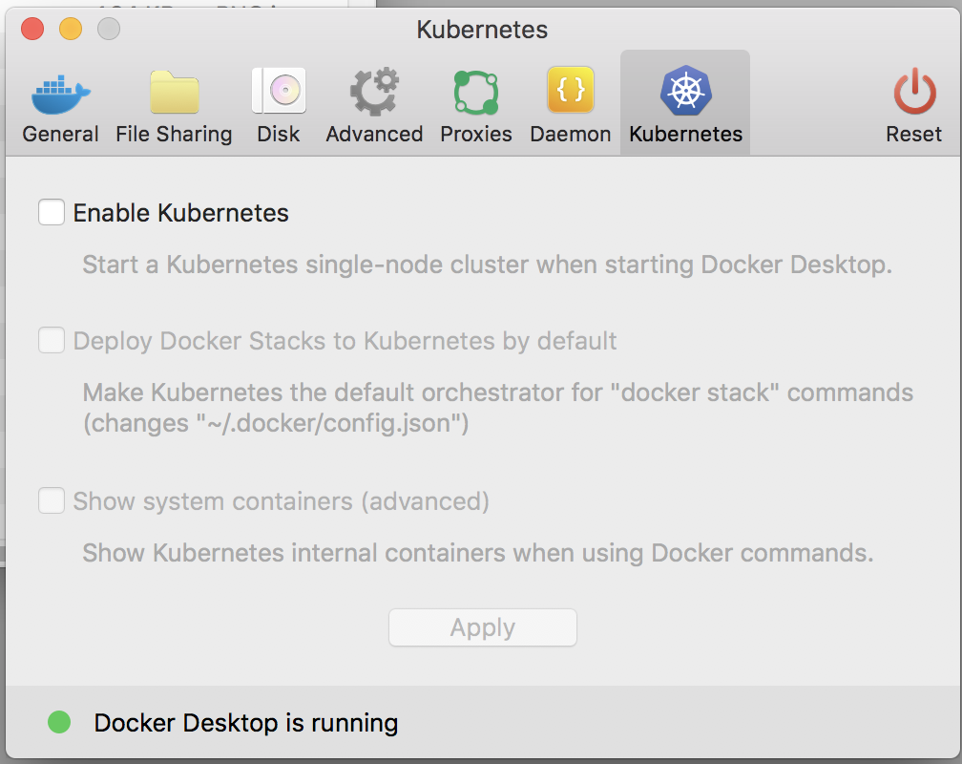
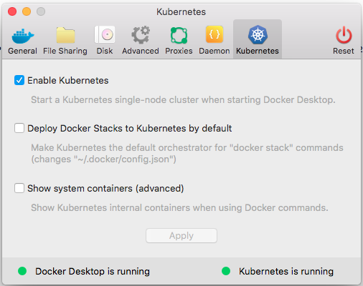
DOCKER-FOR-DESKTOP: ENABLING K8S

Slide 3
HELM: INSTALL COMMAND
# make install-helm install-helm: curl -L https://get.helm.sh/helm-v2.14.3-darwin-amd64.tar.gz | tar xz sudo mv darwin-amd64/helm /usr/local/bin/helm
# make install-tiller install-tiller: helm init --upgrade

Slide 4
COREDNS: INSTALL COMMAND
#make install-coredns install-coredns: helm install stable/coredns --namespace=kube-system --name coredns

Slide 5
KUBERNETES: “DEV” ENVIRONMENT
# make k8s-namespace-create k8s-namespace-create: kubectl create namespace ${PROJECT_ENV} kubectl config set-context --current --namespace=${PROJECT_ENV}

Slide 6
SKAFFOLD: INSTALL COMMAND
# make installl-skaffold install-skaffold: curl -Lo skaffold https://storage.googleapis.com/skaffold/releases/latest/skaffold-darwin-amd64 chmod +x skaffold sudo mv skaffold /usr/local/bin

Slide 7
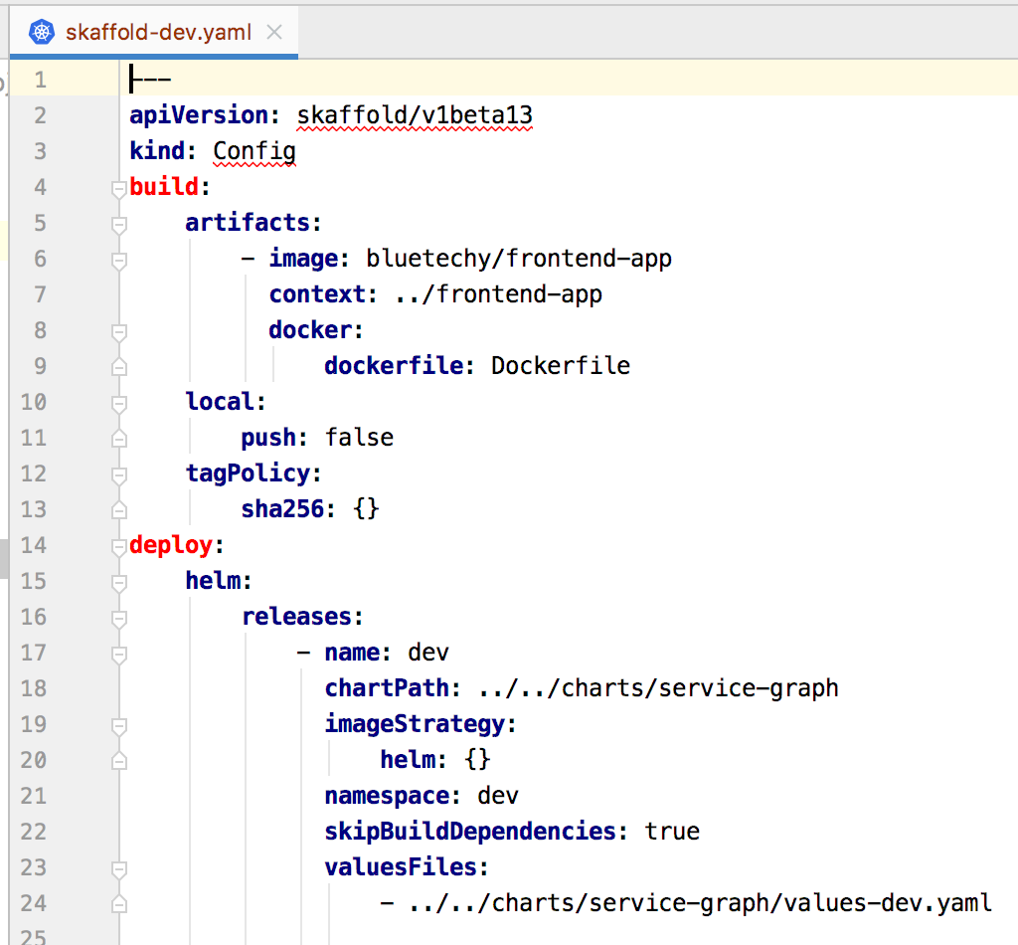
SKAFFOLD: MANIFEST FILE

Slide 8
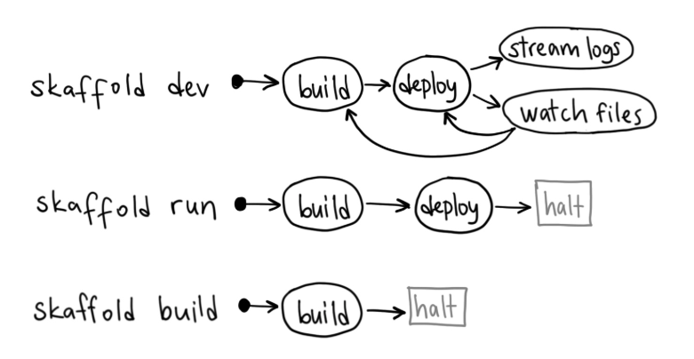
SKAFFOLD: COMMANDS

Slide 9
SKAFFOLD: BUILD COMMAND
# make k8s-graph-build k8s-graph-build: skaffold build -f skaffold-${PROJECT_ENV}.yaml --skip-tests=true

Slide 10
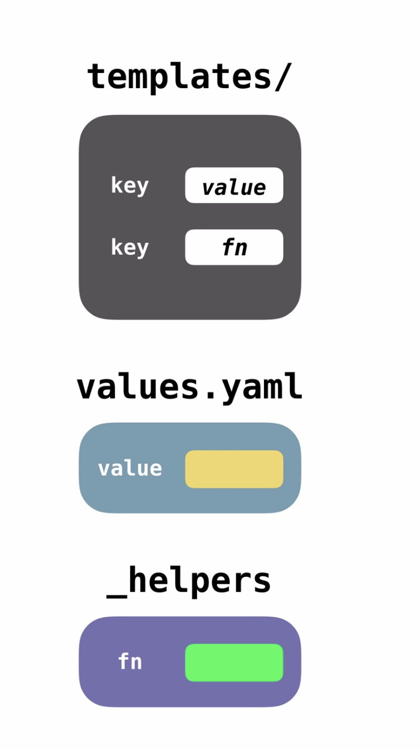
HELM: CHARTS

Slide 11
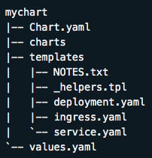
HELM: CHARTS

Slide 12
DOCKER COMPOSE: RUN COMMANDS
# make dc-graph-up-d dc-graph-up-d: dc-graph-down docker-compose -p ${PROJECT_NAME} -f docker-compose-${PROJECT_ENV}.yml up -d
# make dc-graph-down dc-graph-down: docker-compose -p ${PROJECT_NAME} -f docker-compose-${PROJECT_ENV}.yml down docker-compose -p ${PROJECT_NAME} -f docker-compose-${PROJECT_ENV}.yml rm -f

Slide 13
KUBERNETES: RUN COMMANDS
# make k8s-graph-up-d k8s-graph-up-d: k8s-graph-down k8s-graph-build helm install ../../charts/service-graph \ --namespace ${PROJECT_ENV} \ --name=${PROJECT_NAME} \ --values=../../charts/service-graph/values-${PROJECT_ENV}.yaml \ --set repository.rootDir="${ROOT_PATH}"
# make k8s-graph-down k8s-graph-down: (helm delete ${PROJECT_NAME} --purge || true) &> /dev/null

Slide 14
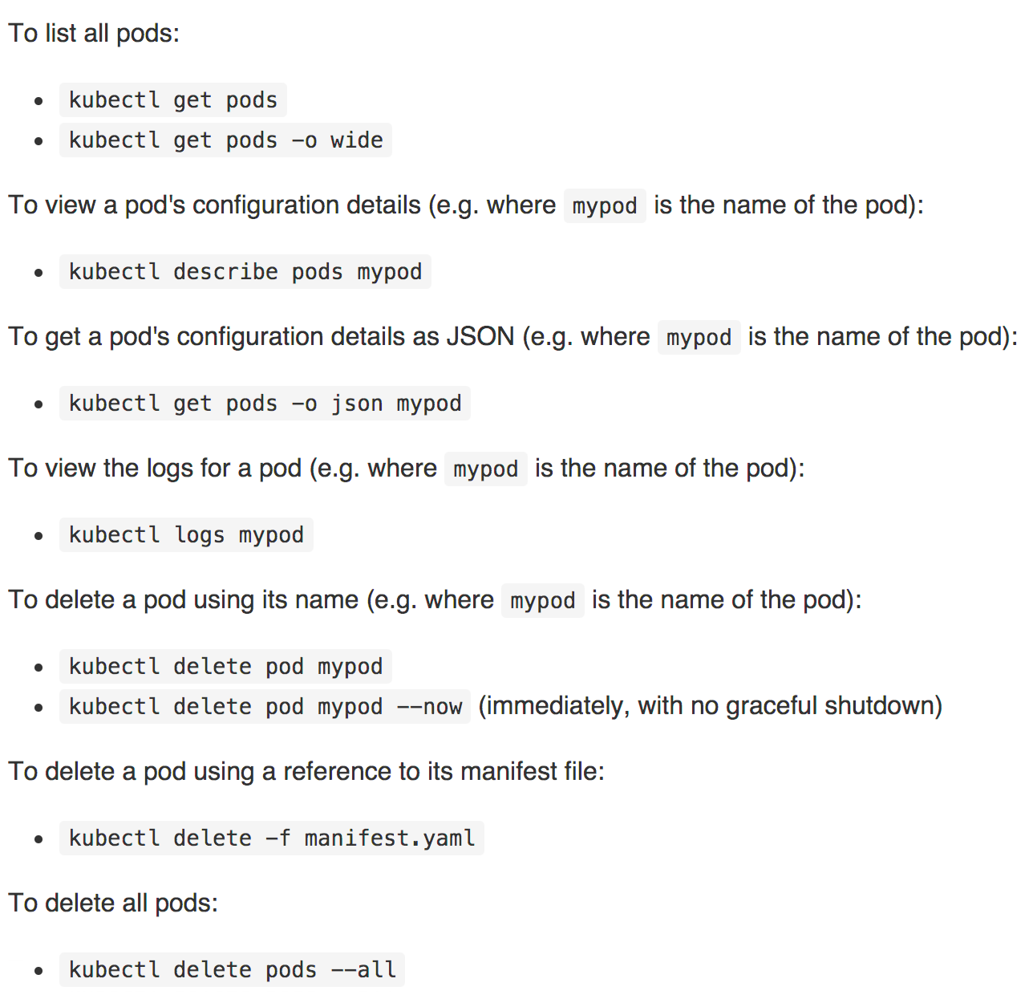
KUBERNETES: KUBECTL COMMANDS

Slide 15
KUBERNETES: INSPECT TEMPLATES
# make k8s-graph-inspect k8s-graph-inspect: helm install ../../charts/service-graph \ --namespace ${PROJECT_ENV} \ --dry-run \ --values=../../charts/service-graph/values-${PROJECT_ENV}.yaml \ --set repository.rootDir="${ROOT_PATH}" \ --debug

Slide 16
KUBETAIL: INSTALL COMMAND
# make install-brew install-brew: /usr/bin/ruby -e "$(curl -fsSL https://raw.githubusercontent.com/Homebrew/install/master/install)”
# make install-kubetail install-kubetail: brew tap johanhaleby/kubetail && brew install --HEAD kubetail

Slide 17
KUBETAIL: RUN COMMAND
# make k8s-graph-log k8s-graph-log: kubetail "^.*depl.*" --regex --namespace ${PROJECT_ENV}

Slide 18
KUBERNETES: ADMIN
# make k8s-admin-create k8s-admin-create: kubectl apply -f dashboard-adminuser.yaml kubectl -n kube-system describe secret $(kubectl -n kube-system get secret | grep admin-user | awk '{print $1}') # make k8s-admin-token k8s-admin-token: kubectl -n kube-system describe secret $(kubectl -n kube-system get secret | grep admin-user | awk '{print $1}')

Slide 19
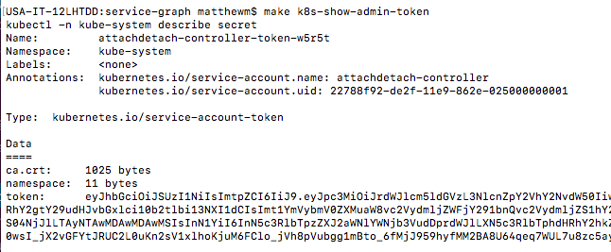
KUBERBETES: ADMIN

Slide 20
KUBERNETES: DASHBOARD
https://kubernetes.io/docs/tasks/access-application-cluster/web-ui-dashboard/
# make k8s-gui-up k8s-gui-up: kubectl apply -f https://raw.githubusercontent.com/kubernetes/dashboard/v2.0.0-beta1/aio/deploy/recommended.yaml kubectl proxy # make k8s-gui-open k8s-gui-open: open http://localhost:8001/api/v1/namespaces/kubernetes-dashboard/services/https:kubernetes-dashboard:/proxy/
# make k8s-gui-down k8s-gui-down: kubectl delete -f https://raw.githubusercontent.com/kubernetes/dashboard/v2.0.0-beta1/aio/deploy/recommended.yaml

Slide 21
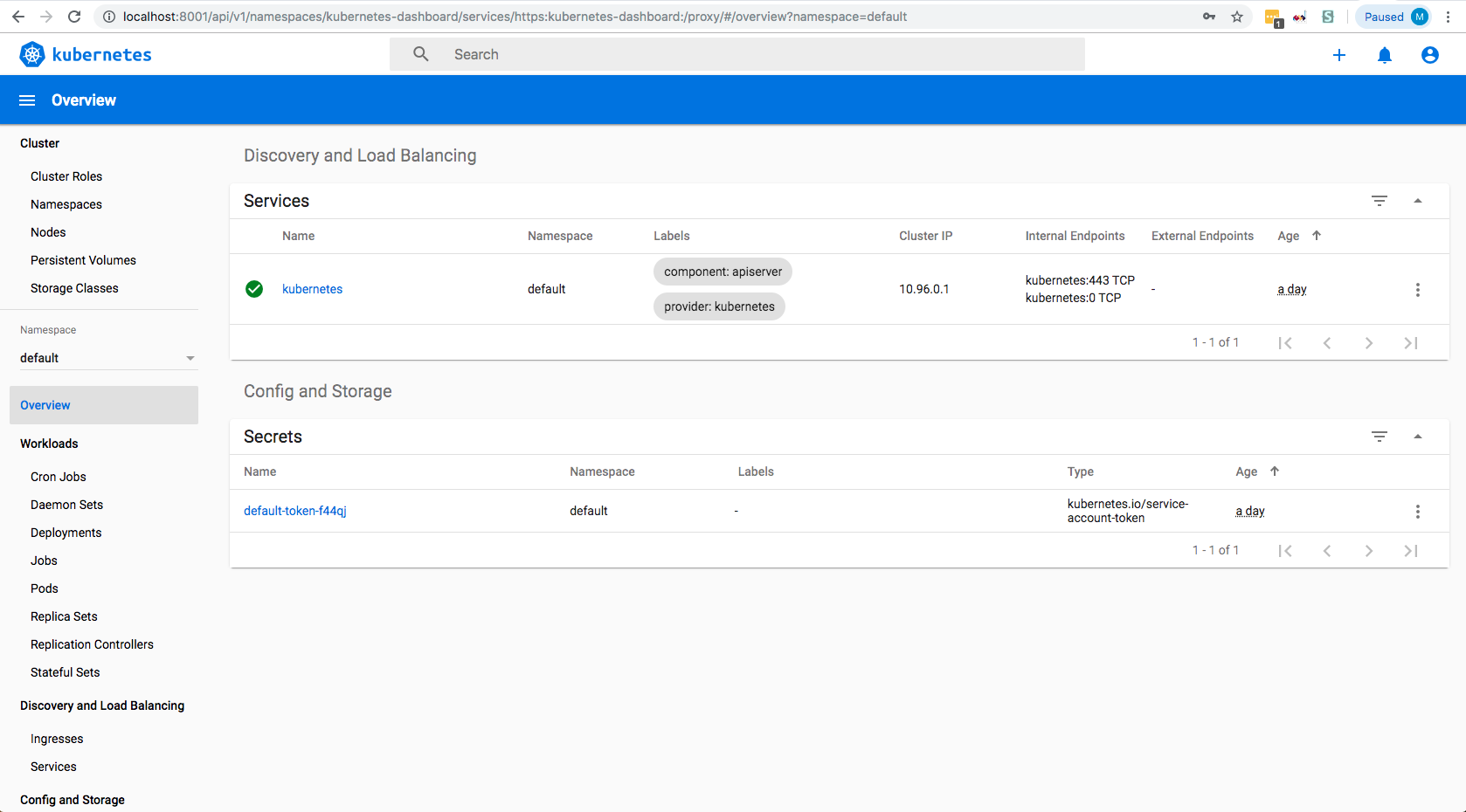
KUBERNETES: DASHBOARD

